Slide 1

AIRPORT MANAGEMENT SYSTEM
Rakesh Chaudhury NUID:001345361
Kiran Ramesh NUID: 001050700
Sachin NUID:001054734
Ashutosh Raichurkar NUID: 001306059

Slide 2

About the Database:
Airline reservation system is one of the most used database systems in the world.
It is an example of Transaction processing systems where large databases and hundreds of concurrent users will be executing database transactions. These systems require high availability and fast response time for hundreds of concurrent users.
We define the concept of a transaction, which is used to represent a logical unit of
database processing, that must be completed in its entirety to ensure correctness. A transaction is typically implemented by a computer program, which includes database commands such as retrievals, insertions, deletions, and updates.
Our database handles most of the functionalities of an Airport Management including reservation, cancellation and updating of a flight trip transaction.

Slide 3


Entities
Airport
Airline Company
Airplane
Base Fare
Parking
Restaurant
Seat
Access
Air Schedule
User
Passenger
Passenger Itinerary
Booking
Room Booking
Room Availability
Hotel

Slide 4
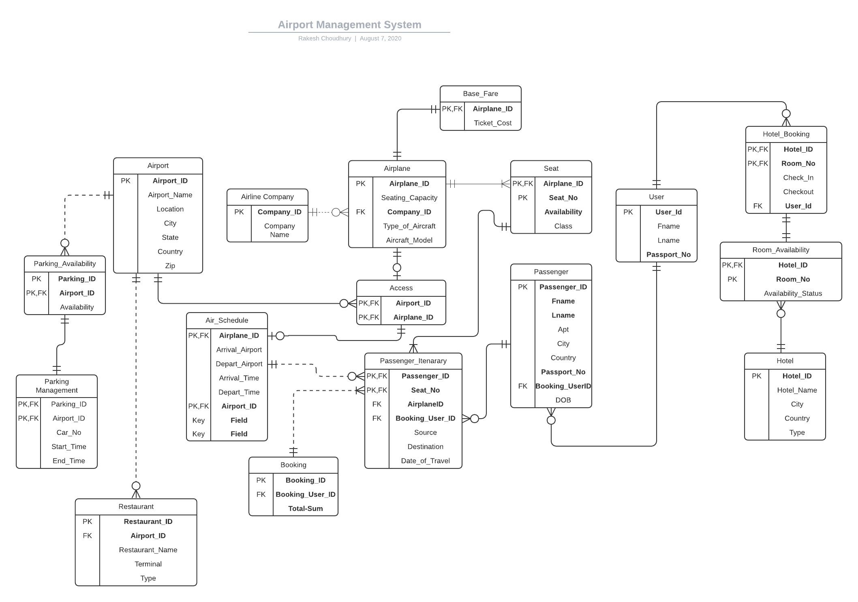
Entity Relationship Diagram

Slide 5
Table Level Constraints
Room Booking : We have used a table level constraint on room Booking Entity, so if a room is not available in the Room Availability entity, then user won't be able to book a room i.e. a row cannot be created in the room booking entity for the unavailable room.
Parking Management: The table level constraint is similar to that of the Room Booking, so a parking spot cannot be occupied or booked in the Airport, if the spot is not available according to the Parking Availability entity.
Air Schedule: A table level constraint is added to the Air Schedule entity to ensure that the Departing and Arrival Airport are not the same for the same aircraft therefore avoiding data inconsistency and providing better validation

Slide 6
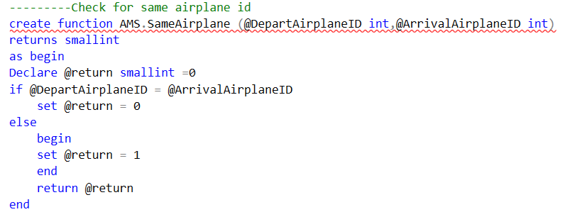
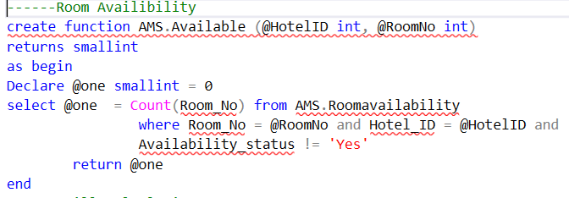
Table Constraints Check Implementation

Slide 7

Computed Columns and Procedures
We have created a column in the Booking entity, which counts the Seats booked by a specific user and calculates the total amount for the respective seats by multiplying it with the cost of the seats.
We have used the procedure in the project to refresh the billing amount for each of the user

Slide 8
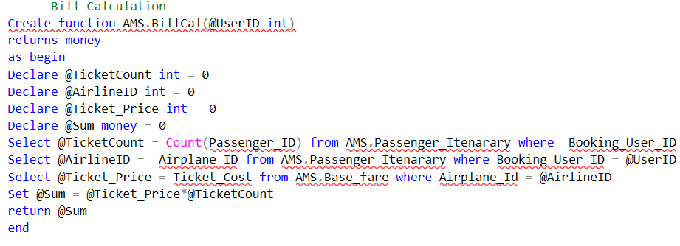
Computed Column for billing the customers

Slide 9
Triggers Used
RoomBooking: A trigger is used at the Room Booking Entity which sets the Availability of the room as ‘No’ , if that particular room is booked and sets the status to ‘Yes’ if the booking is deleted in the Room Booking Entity which means that the room is vacant and is now available.
ParkingManagement: Here the status of the parking spot is changed by the trigger with respect to the occupancy of the spot. The trigger in the ParkingManagement Entity works similar to the Trigger used in RoomBooking Entity
AirSchedule: We have used a trigger on AirSchedule which fetches the name of the Airports based on the AirportID inserted into the Depart AirportID and Arrival AirportID. Error Handling: The source and destination of the airplane cannot be same.

Slide 10
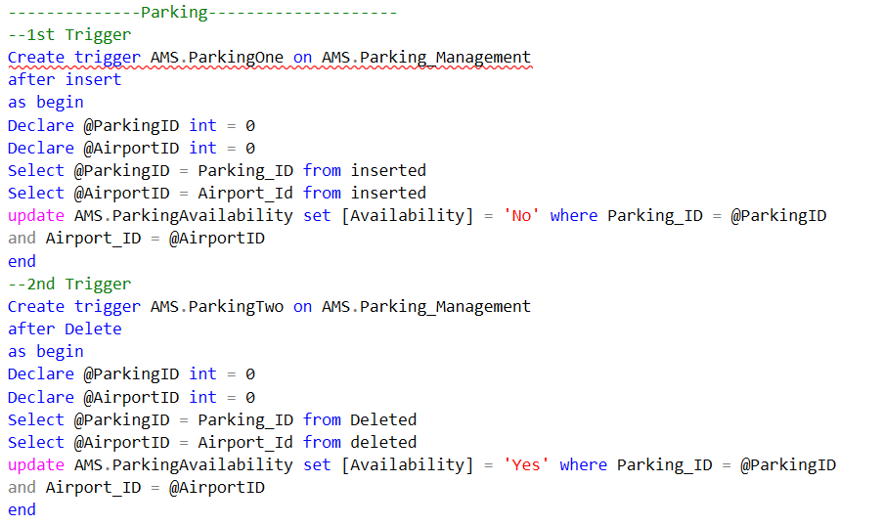
Trigger on Parking Entity

Slide 11
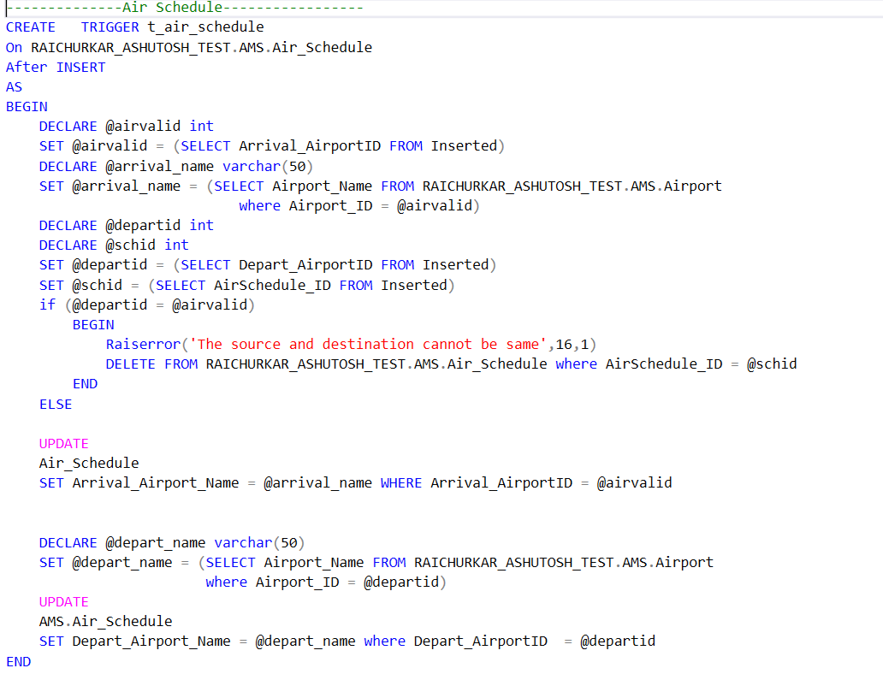
Trigger on Air Schedule Entity

Slide 12
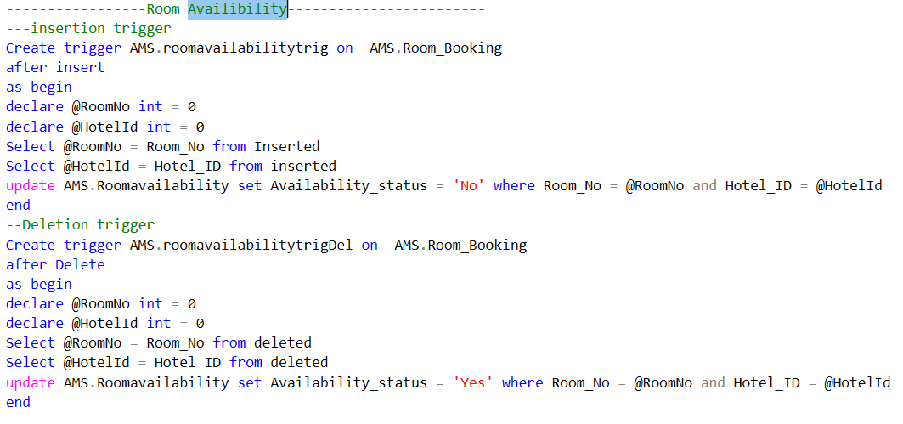
Trigger on Room Availability Entity

Slide 13

VIEWS
Passenger_ETA – This Contains the details of the passenger itinerary and real time estimated time of arrival of flight.
Passenger_Amount_Due- It has the amount remaining for the payment by a passenger and their calculated age, their full name and complete address as report.
Restaurant_Locations- It reports about the restaurants connected with different airport terminals.
VwAirportInfo- This report contains the information for the flights leaving the Mumbai Airport along with departure time and destination.

Slide 14

Encryption
We have used Certificate and Symmetric keys to encrypt the user's password and store it in the database.
Trigger EncryptUserPassword has been created on User table to encrypt the incoming user password before storing it in the database.
We have also written an anonymous block to update the password of users already existing in the database whose password was not encrypted. We used Cursors in the anonymous block in order to update the passwords.

Slide 15
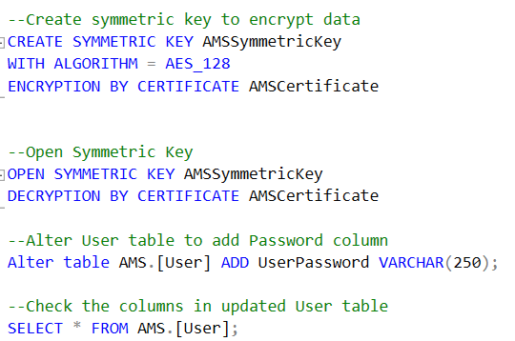
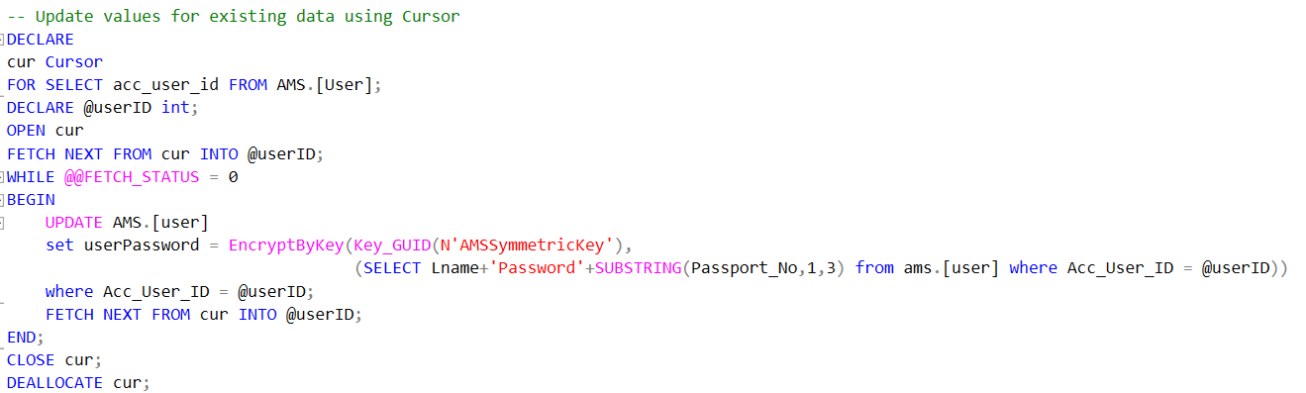
Encryption Implementation
New Users
Existing Users

Slide 16

Thank You

